Slide 1

Implement Bankers Algorithm
By
Your name

Slide 2
Background
Is Resource Allocation and Deadlock Avoidance Algorithm.
It was developed by Edsger Dijkstra
It is name so as it is used in Banking system to check if loan can be provided to customer or not.
Similarly in processes it checks if process is in safe state or not.
We make “S-State ” to check for possible deadlock condition to check if allocation should be granted or not.

Slide 3
Key Point
Resource Allocation:-
Is necessary for any application to be run on the system.
When the users opens any program this will be counted as a process, and therefore requires the computer to allocate certain resources for it to be able to run.

Slide 4
Key Point
Resource Allocation Graph:-
Pictorial representation of the state of a system.
It has complete information about all the process which are holding some resources or waiting for some resources.
Also contains the information about all the instances of all the resources whether they are available or being used by the processes.

Slide 5
Key point
Process:-
Uses different resources and uses resources in following way:-
Request a resource
Use the resource
Release the resource

Slide 6
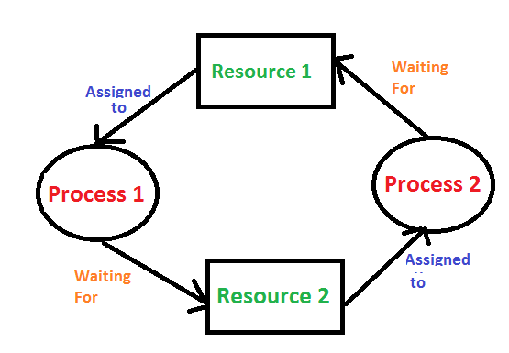
Key point
Deadlock:-
A situation where a set of processes are blocked because each process is holding a resource and waiting for another resource acquired by some other process.

Slide 7
Key point
Safe state:-
A system is in a safe state if the system can allocate resources to each process in some order and let each of them complete successfully.
If process is safe state, then no deadlock else it is in unsafe state.
Don’t grant request if it will cause unsafe state, instead force them to wait.

Slide 8
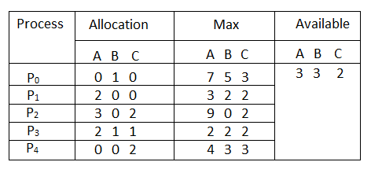
Problem
Considering a system with five processes P₀ through P₄ and three resources of type A, B, C. Resource type A has 10 instances, B has 5 instances and type C has 7 instances. Suppose at time t₀ following snapshot of the system has been taken:

Slide 9
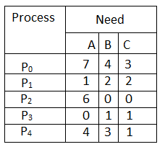
Question1. What will be the content of the Need matrix?
Need [i, j] = Max [i, j] – Allocation [i, j]
So, the content of Need Matrix is:

Slide 10
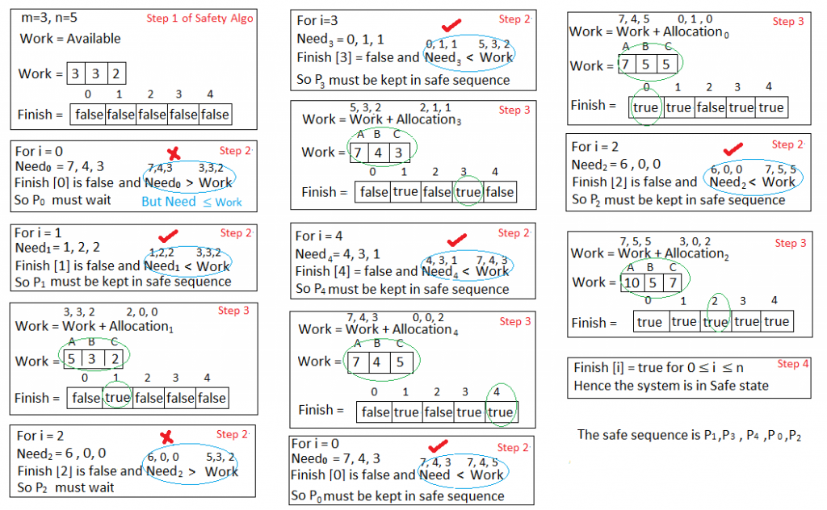
Question2. Is the system in a safe state? If Yes, then what is the safe sequence?
Applying the Safety algorithm on the given system,

Slide 11
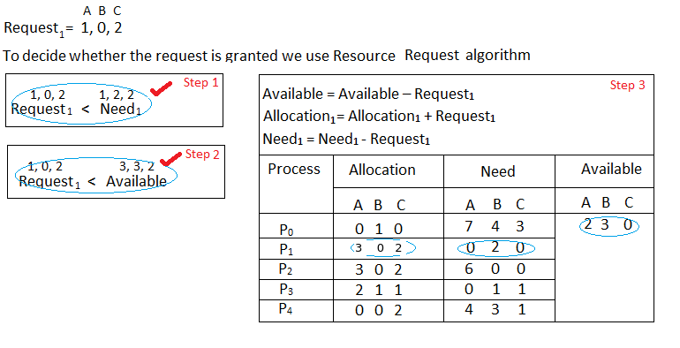
Question3. What will happen if process P₁ requests one additional instance of resource type A and two instances of resource type C?

Slide 12
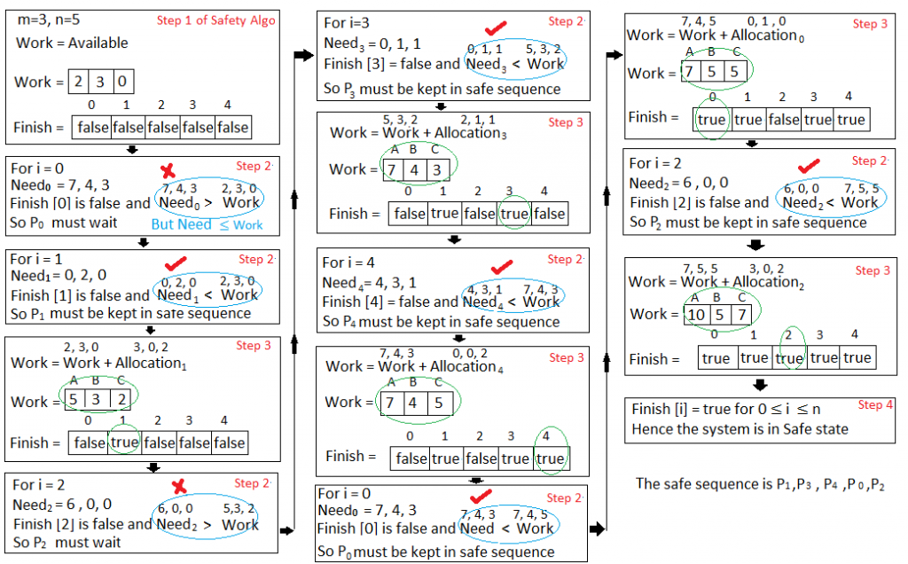
We must determine whether this new system state is safe. To do so, we again execute Safety algorithm on the above data structures.

Slide 13
We must determine whether this new system state is safe. To do so, we again execute Safety algorithm on the above data structures.
Hence the new system state is safe, so we can immediately grant the request for process P_{1 .}

Slide 14

Thank You ☺

